Slide 1
emerging forms of togetherness
photographs and text by Rin Tsuge

Slide 2
Reflection
​
The COVID-19 pandemic has reshaped the way we intersect and connect with one another, affecting every aspect of our lives. All people have had to adapt to new modes of communication, such as remote work and virtual social gatherings, as well as cope with feelings of isolation and disconnection.​
For this project, I have focused on the impact of the COVID-19 pandemic on our daily lives, specifically on the changes to our learning styles before and after the pandemic. Online classes have become a major way of learning after the COVID-19 pandemic, reflecting the deep impact that the pandemic has had on almost every aspect of life, including work, education, socializing, economic, and travel. ​
As I look back at my photo series, I realize how much COVID-19 has affected our lives and communities. The theme I explored was Emerging Forms of Togetherness, and I wanted to know how the pandemic has changed our ability to connect with each other. For the start, I did some research on how Covid 19 has impacted people locally and globally. I was inspired by how people adapted to the challenges of COVID-19, finding creative ways to stay connected despite physical distancing measures.

Slide 3
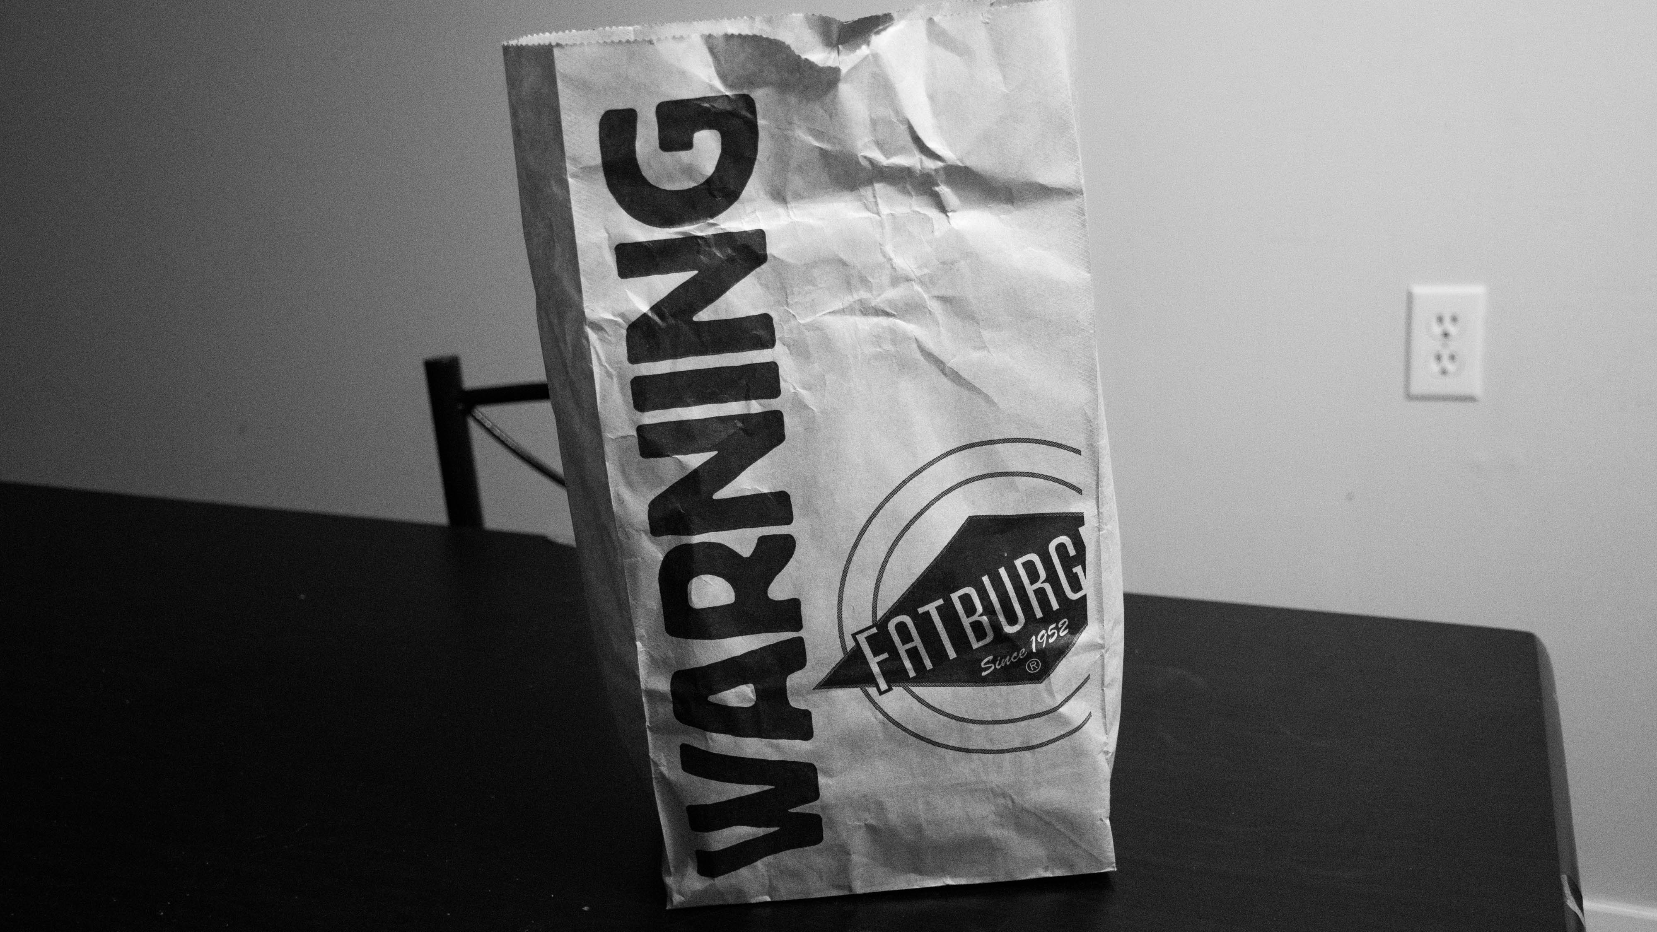

Slide 4
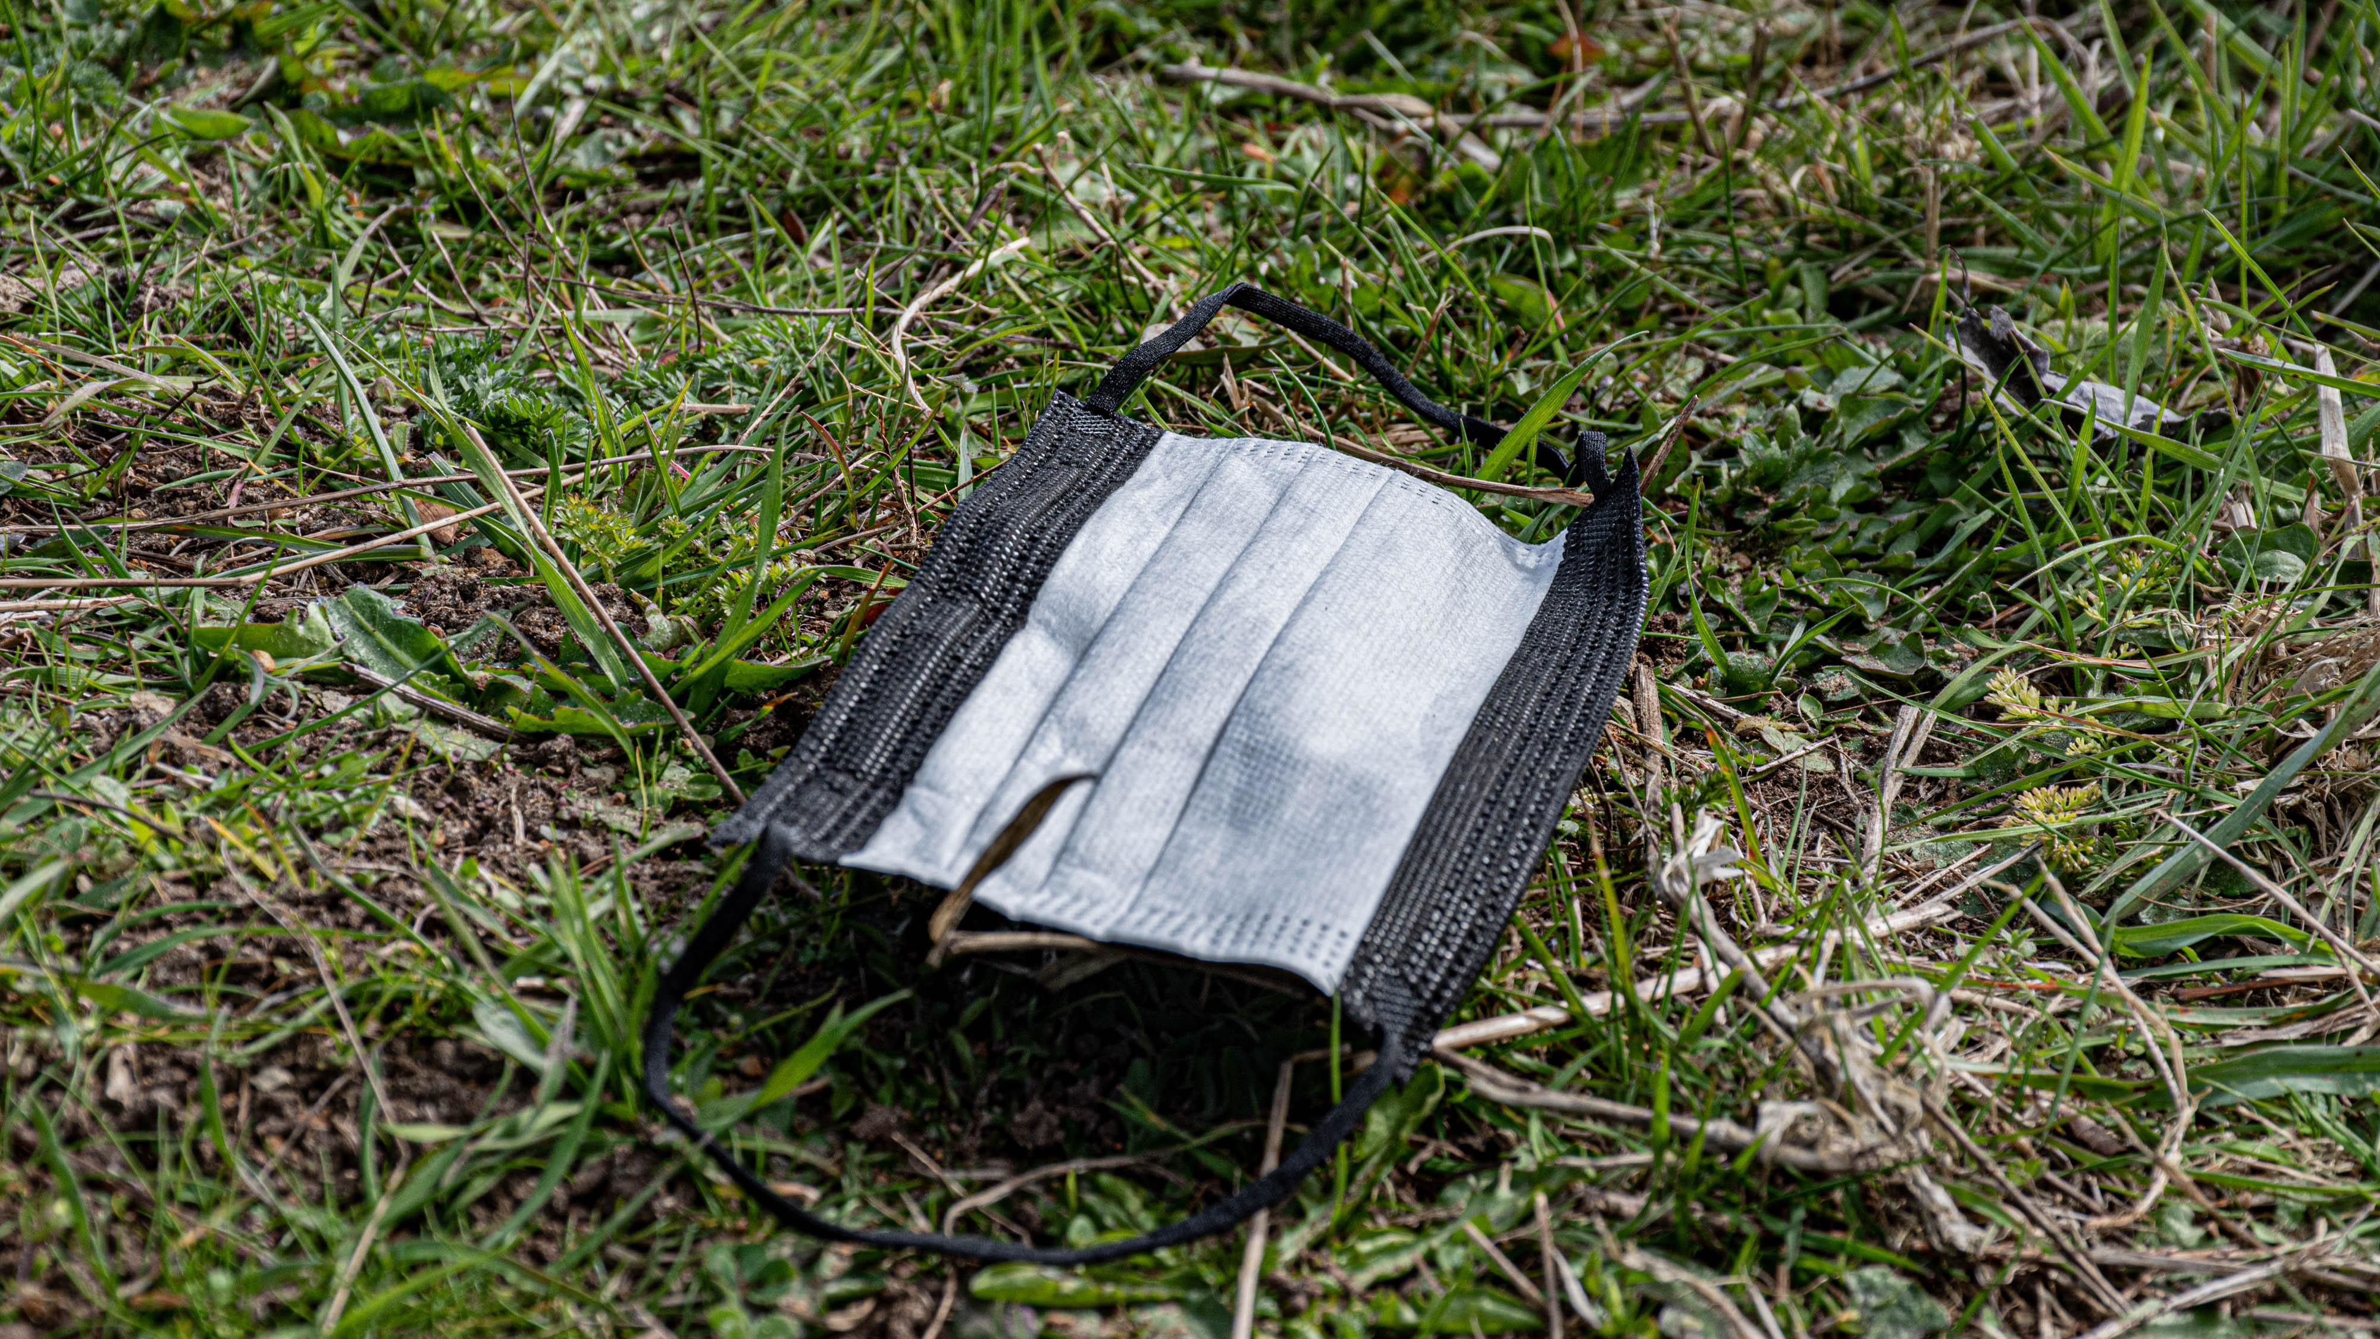

Slide 5


Slide 6


Slide 7


Slide 8
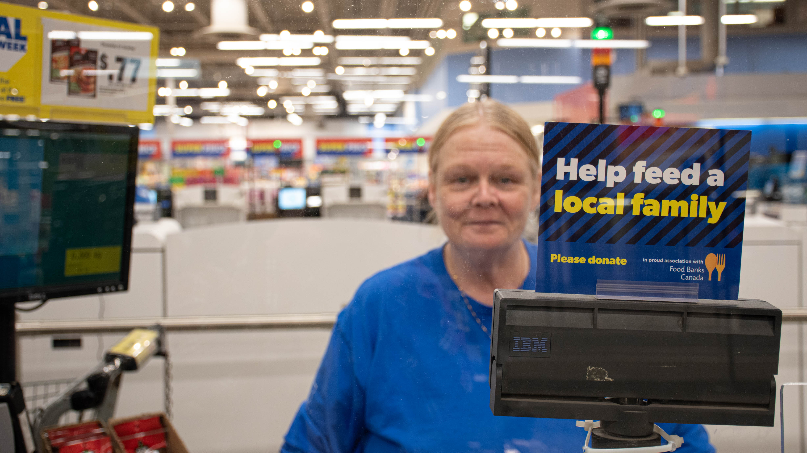

Slide 9
Thank you for watching

